Slide 1

CS 3323
Introduction to Data Structures

Slide 2
Presents major techniques in representing and manipulating data structures: lists, trees, stacks, queues, strings, arrays, graphs, sets and symbol tables. Covers sorting, searching and dynamic storage handling. Formal specification of data structures. Prerequisites: CS 1303 and (CS 2023 or CS 2013).

Slide 3
Data Structures
Definition
  An organization of information, usually in memory, for better algorithm efficiency
Programmers require methods for organizing data
Examples:
  Arrays, linked lists, stacks, queues, binary trees, hash tables, etc.
Central area of study in Computer Science

Slide 4
Algorithms
A computable set of steps to achieve a desired result
Manipulation of data in data structures
  Examples include:
    Searching, Sorting, Displaying
Natural compliment to data structures
  Data structures are byproducts of algorithms
The word comes from the Persian author Abu Ja'far Mohammed ibn Mûsâ al-Khowârizmî who wrote a book with arithmetic rules dating from about 825 A.D.

Slide 5
Running Time
Experimental observation of running time has several limitations:
  Algorithm must be implemented and tested
  Must chose small subset of possible inputs
    Program might behave differently for other inputs
  Hardware and software environments must be constant
We desire a machine independent mechanism for analysis

Slide 6
What’s the Point?
So you know how to program, now what?
What’s wrong with using arrays for everything?
Choice of implementation insignificant versus choice of algorithm or data structure
3 main categories of usefulness
  Real-world data storage
  Programmers tools
  Modeling

Slide 7
Algorithm Efficiency
Running Time
  Algorithm Complexity – computational steps
  Implementation – the actual program
  Execution – hardware configuration
How to measure running time?
How do we compare algorithms?

Slide 8
Efficiency (2)
  The goal is to compare algorithms, not programs
    Generally, the larger the problem, the longer it takes the algorithm to complete
    Sorting 10,000 elements can take much more time than sorting 1,000 elements
      and more than 10 times longer
    We use a variable, n, to denote the "number of things"
    If an algorithm requires 0.025n² + 0.012n + 0.0005 seconds, just plug in a value for n

Slide 9
Running Time as a Function of Input Size
How does processing time relate to number of data elements to be processed?
Express growth in relation to input while ignoring constants associated with hardware, implementation etc.
We work with a new comparison operator:
  Ignores specific function values and concentrates on rate of growth

Slide 10
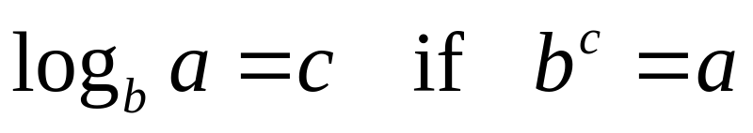
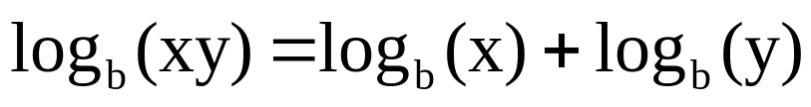
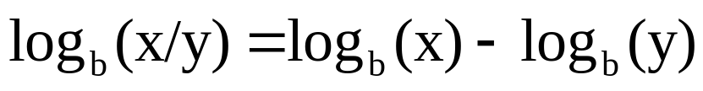
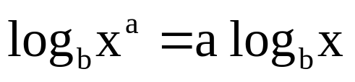
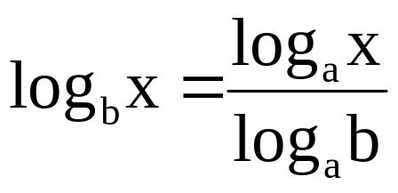
Preliminary Math Review
Logarithm Definition:
Properties:

Slide 11
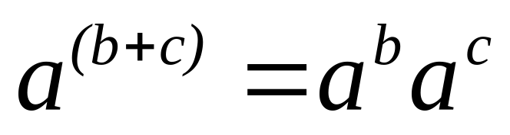
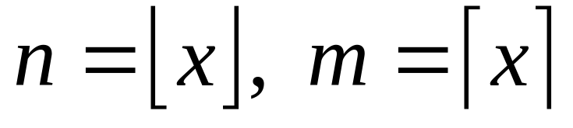
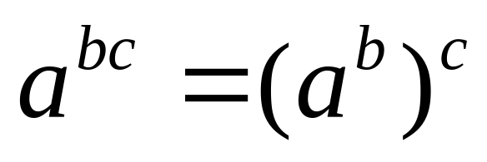
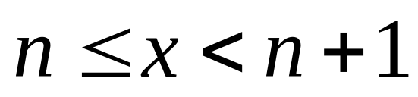
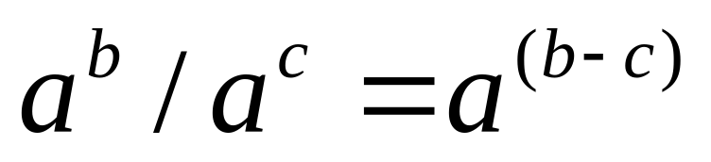
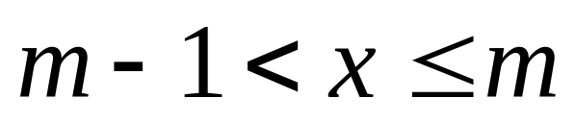
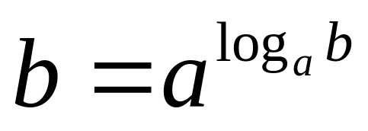
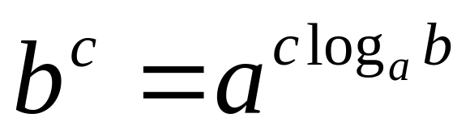
Math Review (2)
Exponentials
Floor & Ceiling
n is the largest integer <= x
m is the smallest integer >=x

Slide 12
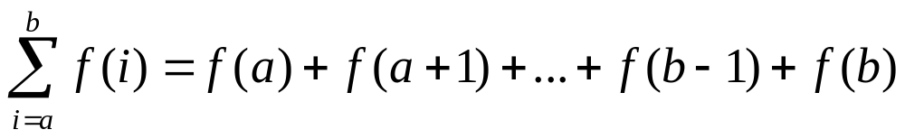
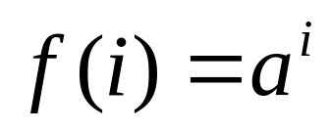
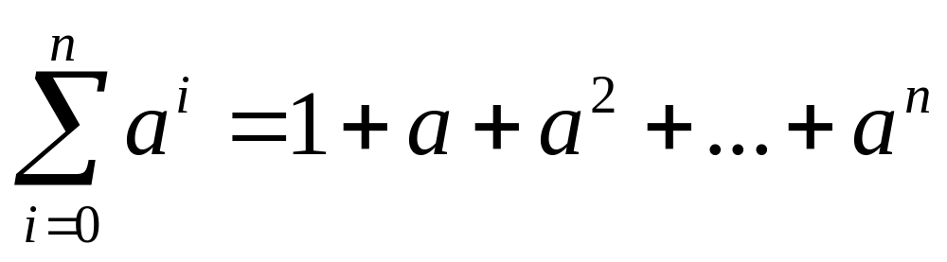
Math Review (3)
Summations
Geometric Progression (exponential growth)

Slide 13
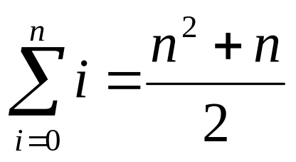
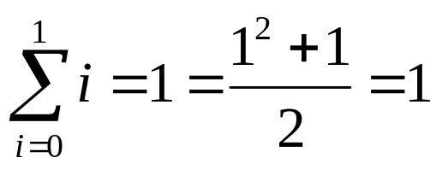
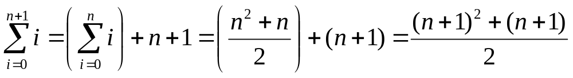
Math Review (4)
Proof by Induction:
Base (n=1)
Induction Hypothesis:
For (n+1)
This is the formula to be shown with n+1
Q.E.D.

Slide 14
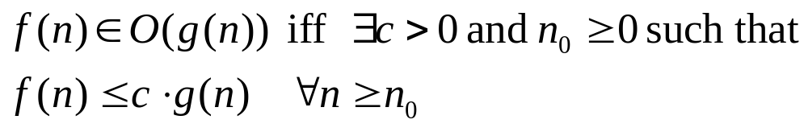
The Big “O”
Recall we were searching for a comparison technique for algorithm complexity
  Independent of constant factors such as hardware and software
we can say: “f is big O of g” or “g is an upper bound on f”
This technique of comparing functions without respect to constants is called asymptotic analysis, and ‘big O’ is only one of the operators used:

Slide 15
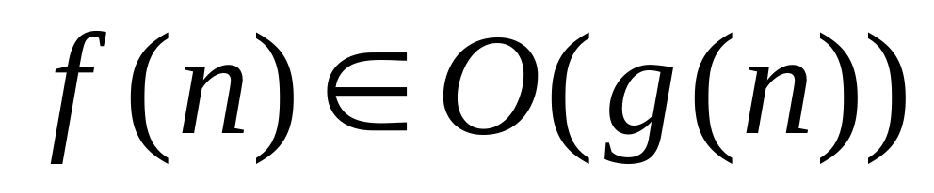
Implies the following:
  We can find a positive constant, c, to multiply g(n) so c*g(n) will dominate f(n) after some point on the x-axis (this point is n₀)
  We can say “f(n) grows no faster than g(n)”
  g(n) provides an upper bound on f(n)
  An algorithm with growth described by f(n) is considered at least as efficient as one with g(n) growth

Slide 16
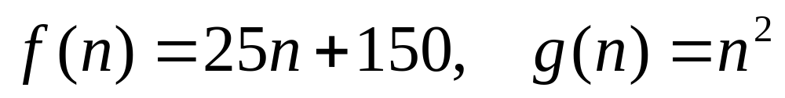
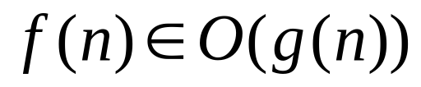
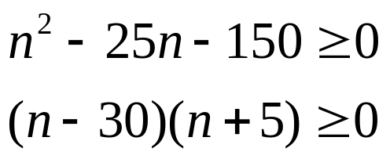
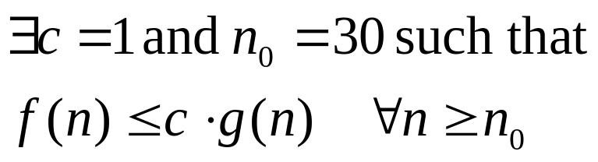
Example of Big O
Consider the following functions
Is ?
try c=1, rearrange to discover when g overcomes f:
  This shows us that g is greater than f when n > 30

Slide 17






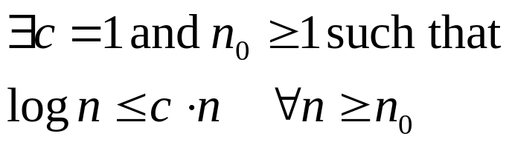
Proving Big O
Theorem 1:
Proof:
  Theorem 2:
  Proof by Induction
    Base (n=0):
    Induction Hypothesis:
    Using (n+1)
  Therefore, using theorem 2:
Thus

Slide 18
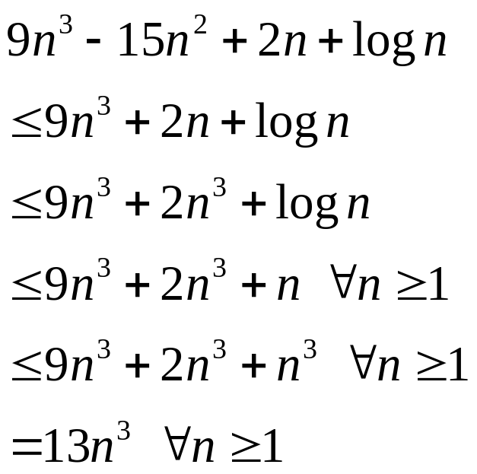
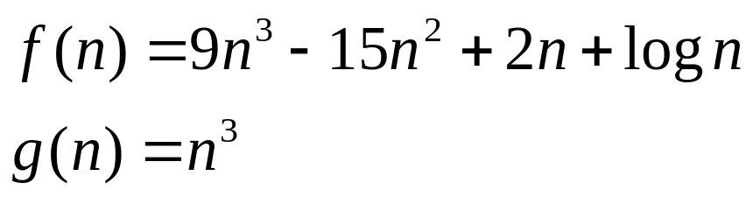

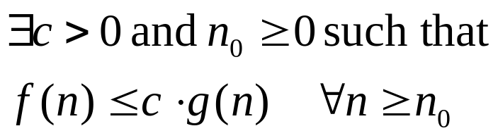
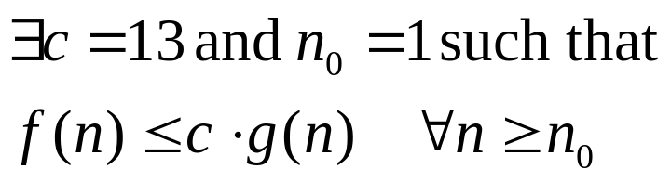

Big O – Proofs (2)
Consider
Proof:
  Must Show
Therefore

Slide 19
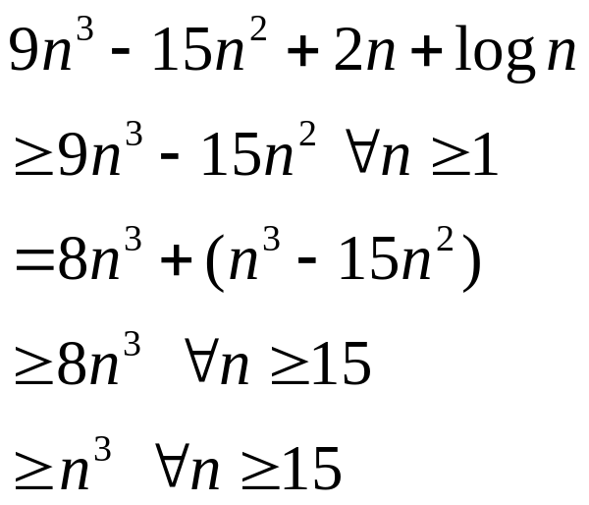

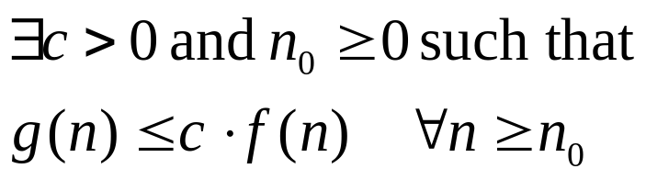
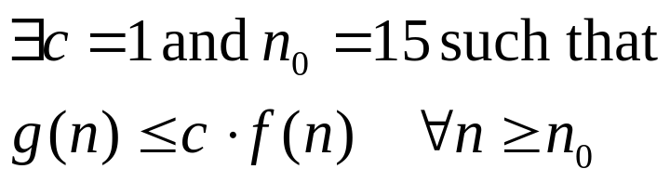

Big O – Proofs (3)
Consider the reverse
Proof:
  Must Show
Therefore

Slide 20
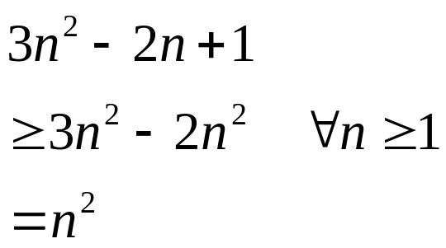
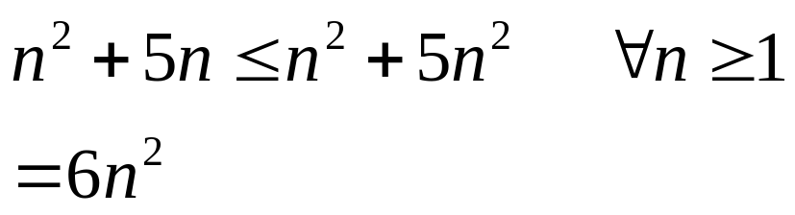
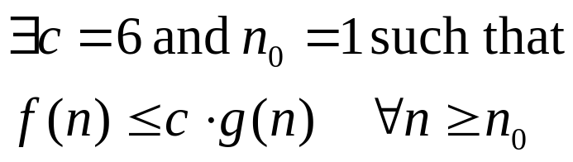
Big O – Proofs (4)
Consider:
we have shown

Slide 21
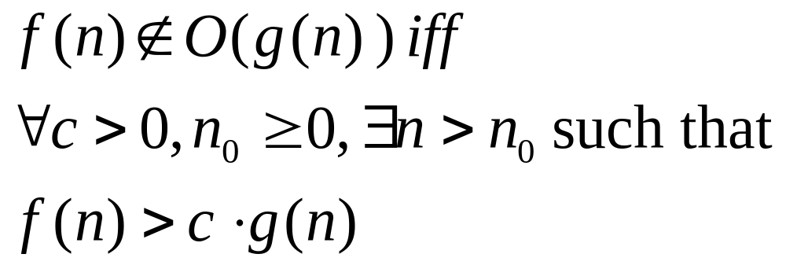
Disproving Big O

Slide 22
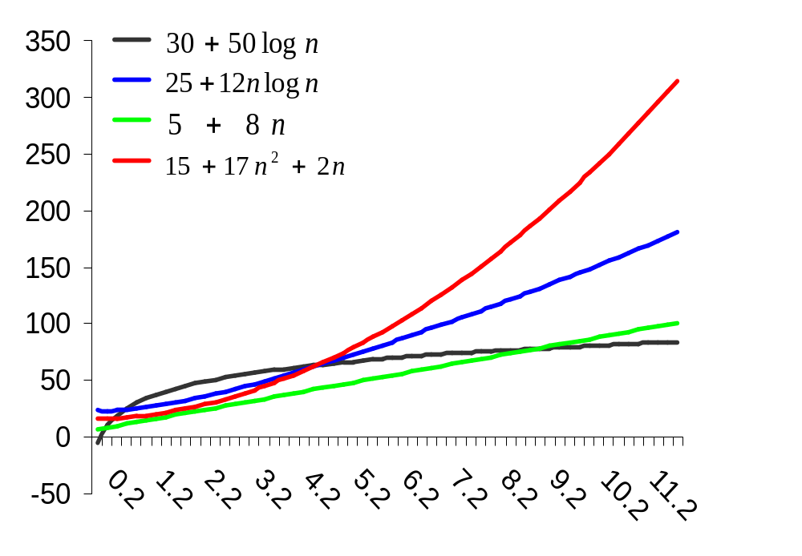







Slide 23
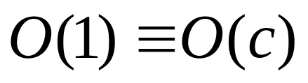
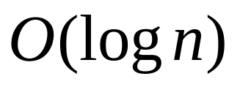
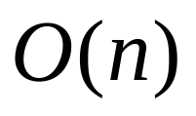
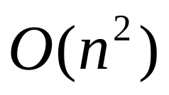
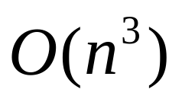
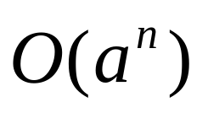
Big O Categorization
Asymptotic Analysis is used to divide functions into categories according to their rates of growth with respect to input size (n).
Increasing Rates of Growth
…

Slide 24
Logarithmic Growth
Many Algorithms are characterized by logarithmic growth
Results from continually splitting data in half
  Binary Search,
  Merge Sort

Slide 25
Poor Searching Example
public static int sillySearch(String[] list, int n, String target)
{
for (int i = 0; i < n; i++) 1+(n+1)+n
{
if (target.equals(list[i]) //** Executes n times n
return i; // found it so quit 0
// Otherwise, shift all elements left by 1 index
// and move first element to the end
int temp = list[0] //** Executes n times n
for(int j=0;j<n-1;j++) //** Executes 1+(n)+n times n(1+n+n)
list[j]=list[j+1]; //** Executes n*n times (worst case) n*n
list[n-1]=temp; n
}// end outer for loop
return -1; // target did not match any ID in the array + 1
}
Worst Case: 3n²+6n+3

Slide 26
Poor Searching Example (2)
public static int sillySearch(String[] list, int n, String target)
{
for (int i = 0; i < n; i++) 1+1+0
{
if (target.equals(list[i]) //** Executes n times 1
return i; // found it so quit 1
// Otherwise, shift all elements left by 1 index
// and move first element to the end
int temp = list[0] //** Executes n times 0
for(int j=0;j<n-1;j++) //** Executes 1+(n)+n times 0
list[j]=list[j+1]; //** Executes n*n times (worst case) 0
list[n-1]=temp; 0
}// end outer for loop
return -1; // target did not match any ID in the array + 0
}
Best Case: 4

Slide 27
A Better Searching Algorithm
public static int linearSearch(String[] list, int n, String target)
{
for (int i = 0; i < n; i++) 1+(n+1)+n
{
if (target.equals(list[index]) //** Executes n times n
return index; // found it so quit 0
}// end outer for loop
return -1; // target did not match any ID in the array + 1
}
Worst Case: 3n+3

Slide 28
A Better Searching Algorithm
public static int linearSearch(String[] list, int n, String target)
{
for (int i = 0; i < n; i++) 1+1+0
{
if (target.equals(list[index]) //** Executes n times 1
return index; // found it so quit 1
}// end outer for loop
return -1; // target did not match any ID in the array + 0
}
Best Case: 4

Slide 29
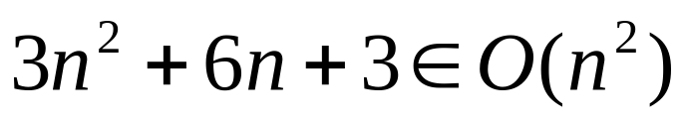
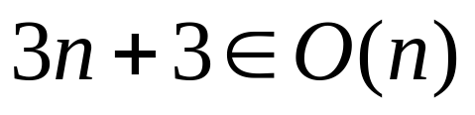
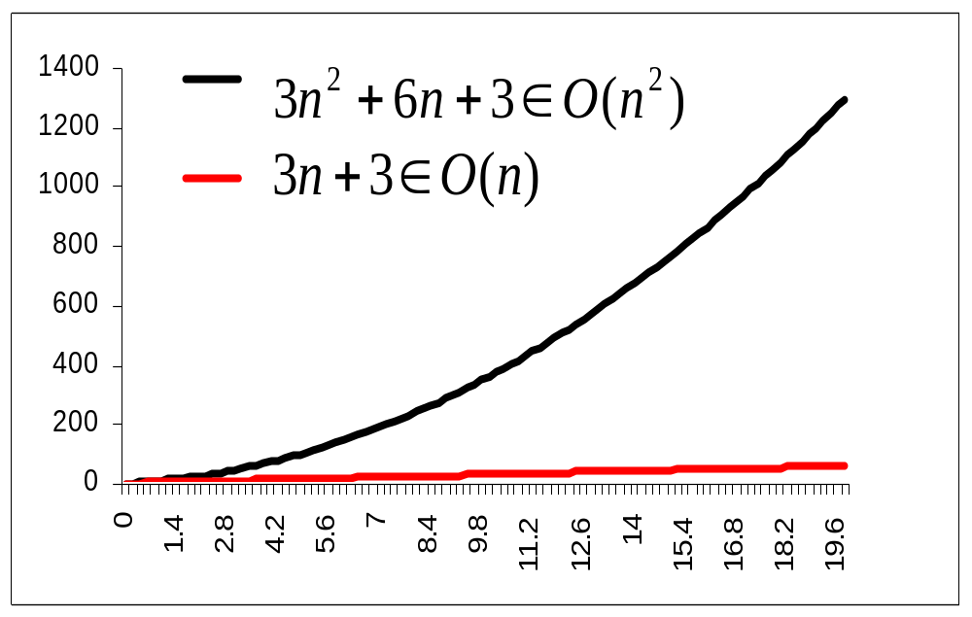
Analysis of sillySearch vs. linearSearch
Use Big O to show upper bound on worst case
sillySearch
linearSearch
Which would you choose?

Slide 30
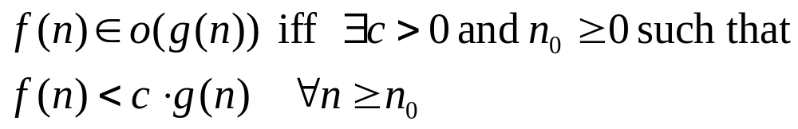


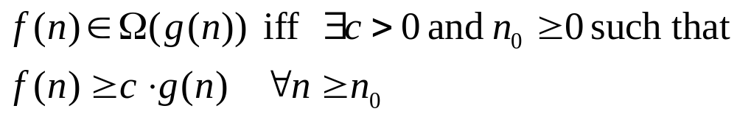

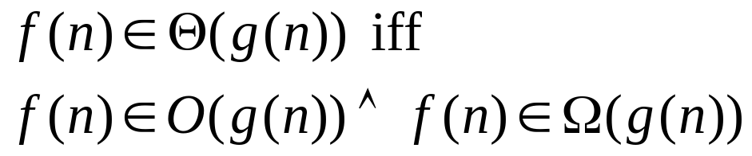

Asymptotic Analysis
“Little o”
“Big O”
“Big omega”
“Theta”

